Slide 1

19CSE352
Business Analytics Group-2
Topic: Credit Card Scoring Recommendation System

Slide 2
Team Members
1. Aadithya E R Menon(CB.EN.U4CSE21301)
Contributions: Pre-processing, PCA, and Component Visualization, ARIMA model
2. Sanjanaa Maturi(CB.EN.U4CSE21353)
Contributions: Pre-processing, EDA, Visualization Plotly , Identify patterns, ARIMA model
3. Sathish J(CB.EN.U4CSE21354)
Contributions: Association Rule mining And Recommendation System, ARIMA model and evaluation
4. Sharan K(CB.EN.U4CSE21355)
Contributions: Association rule mining Visualization And collaborative filtering, stationary check, model evaluation

Slide 3
Introduction
The financial services industry faces the challenge of personalizing product recommendations to enhance customer satisfaction and engagement.
Traditional methods often fall short in capturing individual user preferences effectively.
Challenges include reliance on transactional association rules, which may not fully capture user preferences, and collaborative filtering, which might overlook less obvious but valuable associations.
To address these challenges, a hybrid recommendation approach combining association rule mining and collaborative filtering is proposed.

Slide 4
Problem statement
Problem Statements Addressed
Individual Items: Enhancing personalization of product recommendations in financial services.
User-Based Scenarios: Improving cross-selling and up-selling by tailoring recommendations to individual users.
Goals of the Hybrid Recommendation System
Combine association rule mining and collaborative filtering to generate personalized and contextually relevant recommendations.
Utilize historical transaction patterns and product similarities to recommend beneficial and relevant financial products.
Optimize marketing strategies, improve customer retention, and increase product uptake in the financial sector.

Slide 5
Dataset overview
Dataset Overview
The dataset consists of financial transaction data used for analysis.
It contains 50,000 entries and 27 attributes.
Key Fields
Customer_ID
Month
Age
Annual_Income
Monthly_Inhand_Salary
Num_Bank_Accounts
Num_Credit_Card
Interest_Rate
Num_of_Loan
Type_of_Loan
Delay_from_due_date
Credit_Utilization_Ratio
Credit_History_Age
Total_EMI_per_month
Payment_Behaviour
Monthly_Balance
Data Cleaning Observations
Missing values in several columns (e.g., Name, Monthly_Inhand_Salary, Type_of_Loan).
Inconsistencies in data types for 'Age' and 'Annual_Income' (e.g., special characters, incorrect formats).
Actions taken include removing non-numeric characters and filling missing values with median/mode.

Slide 6
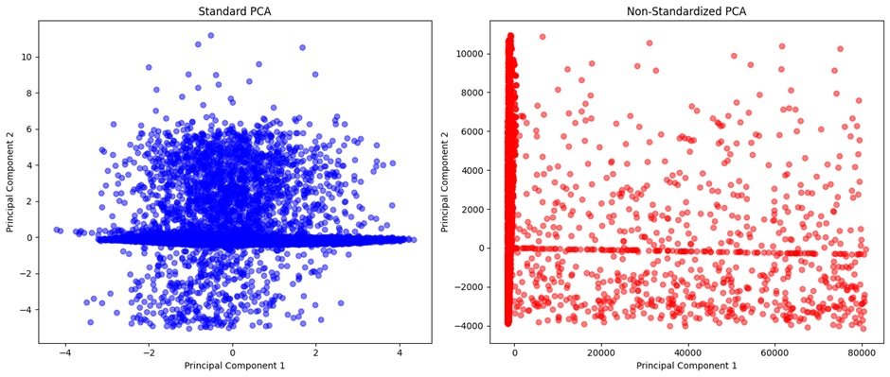
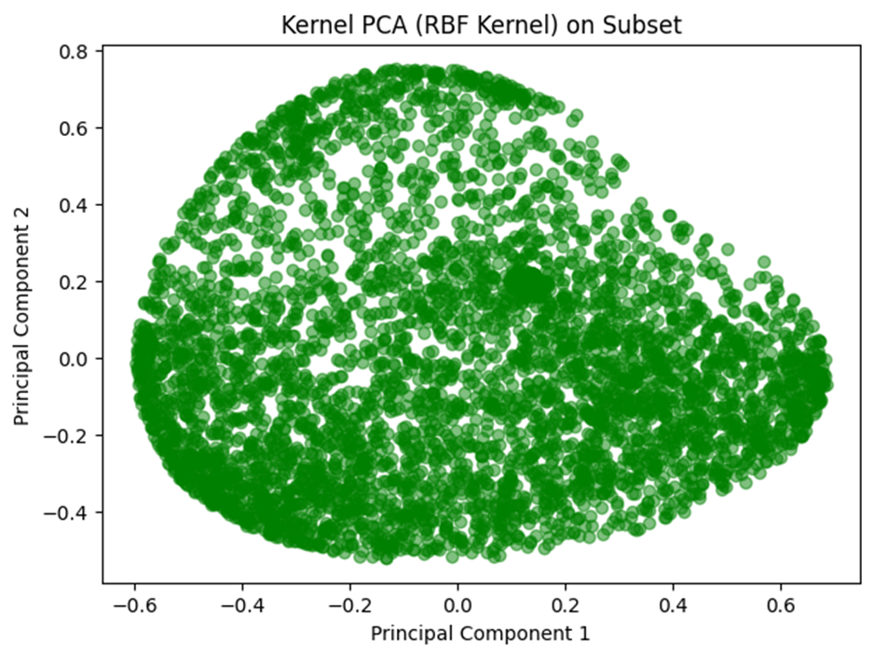
Principal component analysis(pca)
PCA is a technique for dimensionality reduction in data analysis.
It identifies patterns in data and expresses it in a new set of variables called principal components.
Role of PCA
Reduces the dimensionality of the dataset while preserving most of the important information.
Helps in visualizing high-dimensional data and identifying underlying patterns.
Visualizations
Standard PCA: Scatter plot of principal components 1 and 2.
Non-Standardized PCA: Another scatter plot using original data without standardization.
Insights from PCA Explained Variance Ratios
Standard PCA explained variance: [0.1637, 0.1264]
Non-standardized PCA explained variance: [0.8898, 0.1068]
These ratios indicate the proportion of variance explained by each principal component.

Slide 7
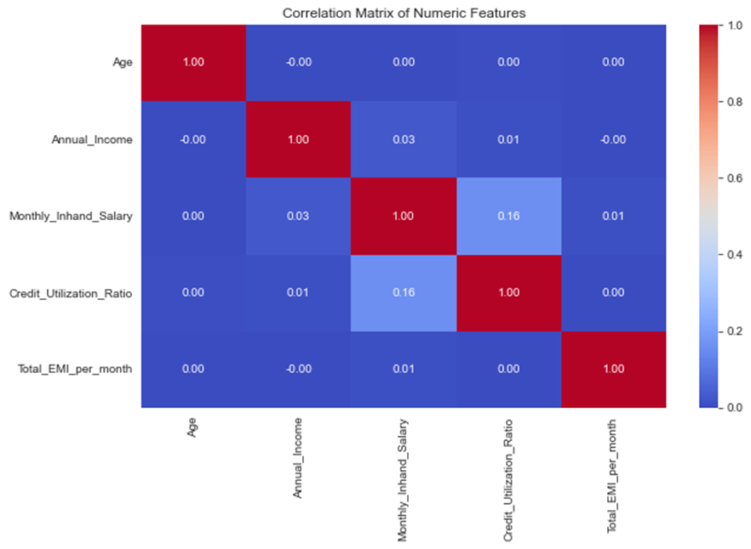
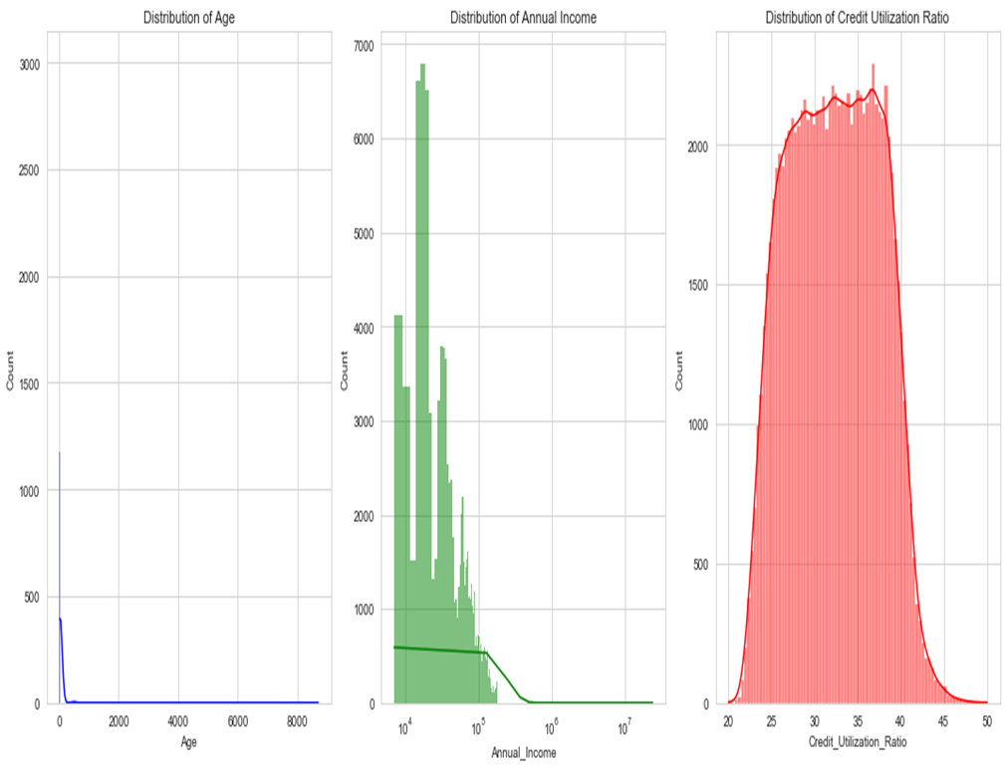
Exploratory data analysis(eda)
Distributions of Key Features
Histograms of Age, Annual Income, and Credit Utilization Ratio.
Insights into the distribution patterns and skewness of the data.
Correlation Matrix Insights
Correlation heatmap of selected numerical features (Age, Annual Income, etc.).
Analysis of correlations between features, such as Age and Annual Income.
Analysis of Categorical Variables
Visualization of top 10 Occupations, Credit Mix distribution, and Payment Behaviour distribution.
Understanding the diversity and distribution of categorical variables in the dataset.

Slide 8
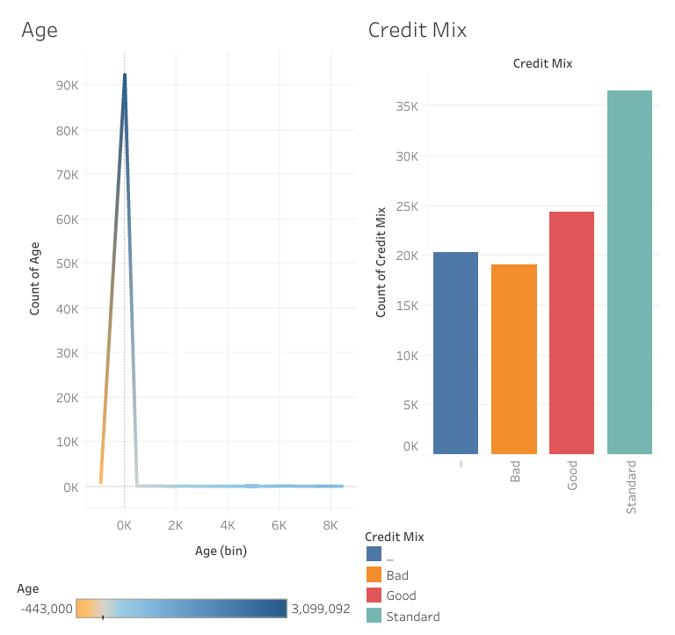
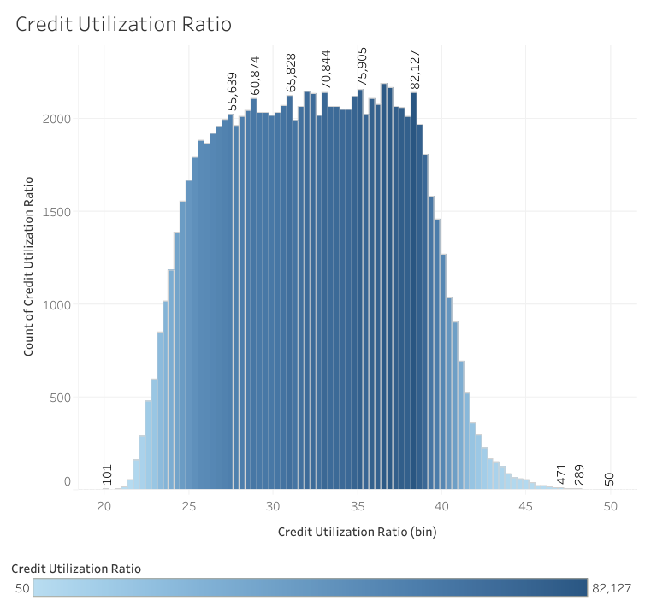
Tableau visualizations

Slide 9
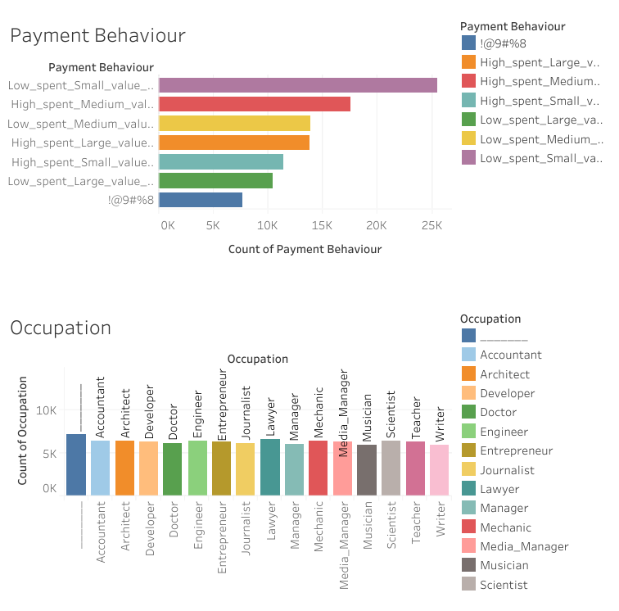
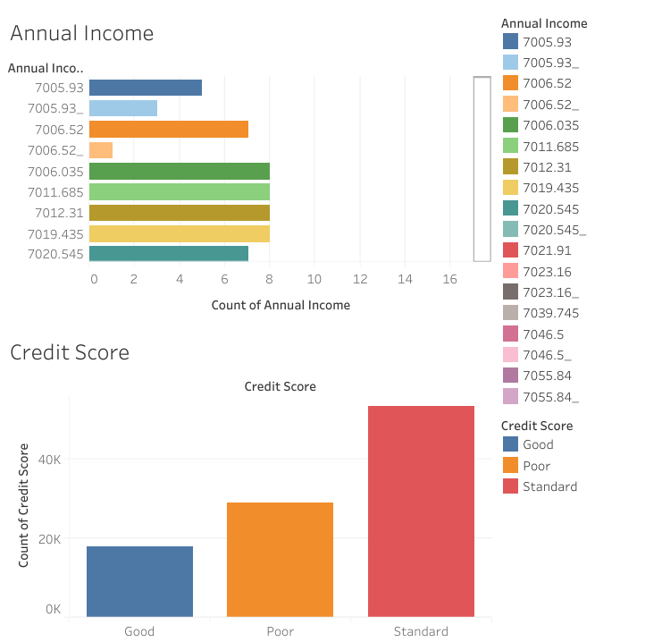
Tableau visualizations

Slide 10
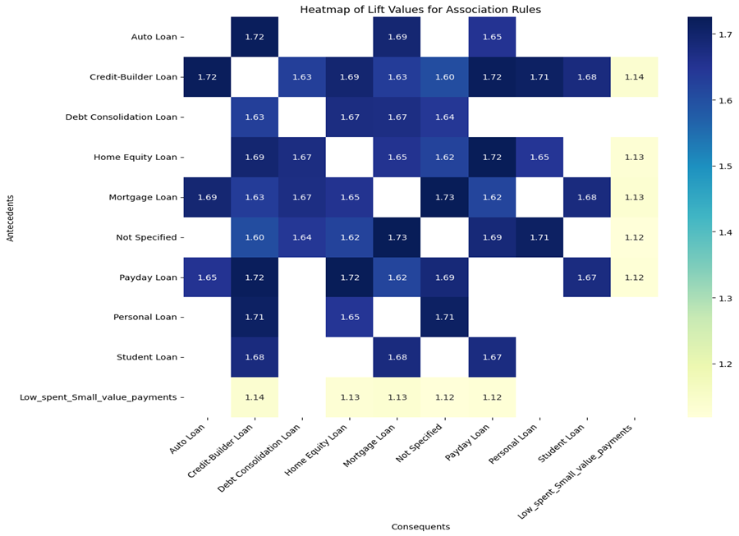
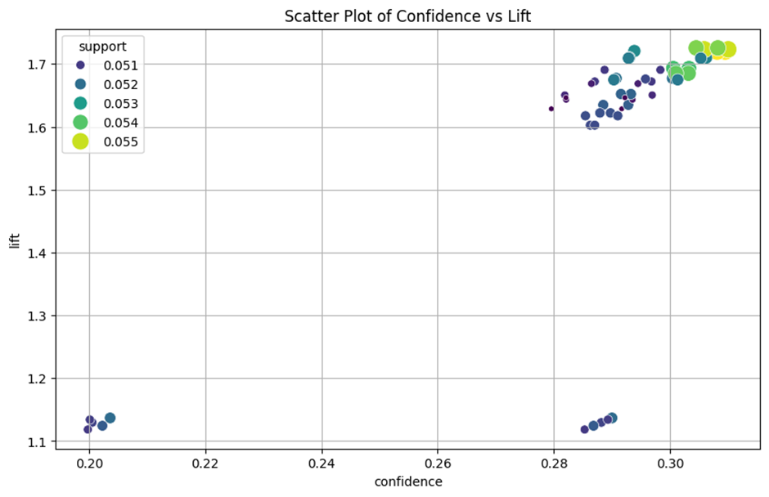
Association rule mining
Association rule mining is a technique used to discover interesting relationships or associations between variables in large datasets.
It involves identifying frequent patterns or itemsets and generating rules that describe the relationships between items
.
Example Association Rules and Insights
Showcase example association rules discovered from the dataset, such as "If a customer exhibits behavior X, they are likely to exhibit behavior Y."
Insights into the discovered rules, highlighting interesting patterns and relationships between different financial behaviors.
Visualization of Association Rules (Heatmap)
Heatmap visualization depicting the strength of association between different financial behaviors.
The heatmap provides a clear visual representation of the relationships captured by the association rules, with higher values indicating stronger associations.

Slide 11

Collaborative filtering
Collaborative filtering is a recommendation technique that predicts user preferences based on past interactions and similarities with other users or items.
It does not rely on explicit features of items but rather on patterns of user behavior.
Construction of Interaction Matrix and Item Similarity
The interaction matrix is constructed from the dataset, where rows represent users and columns represent items, with entries indicating user-item interactions.
Item similarity is calculated using techniques like cosine similarity, measuring the similarity between items based on user interactions.
Example of Collaborative Filtering Recommendation
An example recommendation is generated by identifying items similar to those interacted with by the user.
By leveraging the interaction matrix and item similarity, collaborative filtering predicts user preferences and suggests relevant items for recommendation.

Slide 12
Hybrid recommendation system
The hybrid recommendation system combines the strengths of association rule mining and collaborative filtering.
It leverages both historical transaction patterns and similarities between different financial products to generate personalized recommendations.
Examples of Hybrid Recommendations for Individual Items
Showcases recommendations for individual items by combining association rules and item-based collaborative filtering.
Illustrates how the system generates highly personalized and contextually relevant recommendations for financial products.
Example of Hybrid Recommendations for User-Based Scenarios
Demonstrates recommendations tailored to individual users by integrating insights from association rules and collaborative filtering.
Highlights how the system optimizes marketing strategies, improves customer retention, and increases the uptake of financial products.

Slide 13
Hybrid recommendation system for individual items
Problem statement:
In the context of financial services, there is a need to enhance the personalization of product recommendations to increase customer satisfaction and engagement. Traditional methods either rely solely on transactional association rules, which may not fully capture individual user preferences, or on collaborative filtering, which might miss less obvious but potentially valuable associations.
Objective:
The hybrid recommendation system combines association rule mining and item-based collaborative filtering to provide highly personalized recommendations for financial products like loans and payment behaviors. By leveraging transaction patterns and product similarities, it suggests relevant new products to enhance customer satisfaction and engagement.
Recommendations:
'High_spent_Large_value_payments' (score: ~0.5078)
'High_spent_Small_value_payments' (score: ~0.4913)
'Low_spent_Large_value_payments' (score: ~0.4539)
'Low_spent_Medium_value_payments' (score: ~0.4281)
'Low_spent_Small_value_payments' (score: ~0.4212)
Insights:
Users engaging in 'High_spent_Medium_value_payments' likely engage in similar behaviors.
Recommendations are based on association strength and behavior similarity.

Slide 14
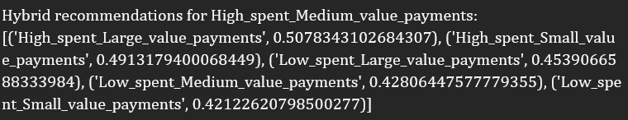
HYBRID RECOMMENDATION SYSTEM FOR INDIVIDUAL ITEMS
Output

Slide 15
Hybrid recommendation system for user-based scenarios
Problem statement
Financial institutions often struggle with effectively cross-selling and up-selling products to existing customers due to a lack of understanding of customer needs at a granular level. Existing systems may not effectively utilize the wealth of data on customer behaviors and product relationships.
Objective
The hybrid recommendation system aims to personalize financial product recommendations by integrating association rules and item-based similarities. This enhances relevance based on user interactions and product properties, optimizing marketing, retention, and product uptake.
The hybrid recommendation system provides a ranked list of recommended loan types based on user interactions and dataset patterns:
'Credit-Builder Loan' (Score: ~0.2315): Highest recommendation based on user behavior and dataset associations.
'Payday Loan' (Score: ~0.2274): Highly relevant to the user, closely following the top recommendation.
'Mortgage Loan' (Score: ~0.2270): Slightly lower recommendation strength but still significant.
'Home Equity Loan' (Score: ~0.2265): Nearly as suitable as a Mortgage Loan for the user.
'Not Specified' (Score: ~0.2234): Indicates relevance to other unspecified loan types or financial products.

Slide 16

HYBRID RECOMMENDATION SYSTEM FOR USER-BASED SCENARIOS
Output

Slide 17
interpretation
The scores indicate the relevance of recommended items based on association rules and item similarity. They represent a combination of association strength and item similarity, reflecting how likely users are to prefer an item given their preferences and its similarity to items they've interacted with. This ranked list of recommendations guides users toward the most suitable financial products, supported by quantitative measures of predicted relevance for prioritization and exploration.

Slide 18

Time series analysis- arima

Slide 19
Problem statement
The goal is to forecast future financial metrics such as Monthly_Inhand_Salary This could help in predicting financial trends, customer behavior, and credit risks, which is valuable for making informed business decisions, tailoring customer offers, or managing risk.

Slide 20
Dataset overview
Dataset:
Contains 50,000 entries.
Consists of 27 columns, comprising both numerical and categorical data.
Key columns
Month
Represents the month of the financial data.
Monthly Inhand Salary
Indicates the salary after deductions for each month.
Monthly Balance
Reflects the balance amount at the end of each month.
Amount Invested Monthly
Denotes the monthly investment amounts made by individuals.

Slide 21
Data preprocessing steps
Missing Values Handling:
Utilized mean for numerical columns and mode for categorical columns to handle missing values.
Data Type Conversion:
Converted 'Month' column to datetime format for better analysis.
Ensured correct data types for numerical columns such as 'Annual_Income' and 'Outstanding_Debt'.
Relevant Data Filtering:
Focused on columns pertinent to time series forecasting, such as 'Monthly_Inhand_Salary', 'Monthly_Balance', and 'Amount_invested_monthly'.

Slide 22
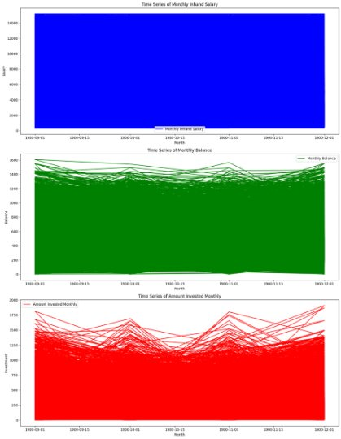
visualization
Time Series Plots:
Monthly Inhand Salary: Depicts the trend of salary over time.
Monthly Balance: Illustrates the fluctuation in balance across months.
Amount Invested Monthly: Shows the variation in investment amounts over time.

Slide 23
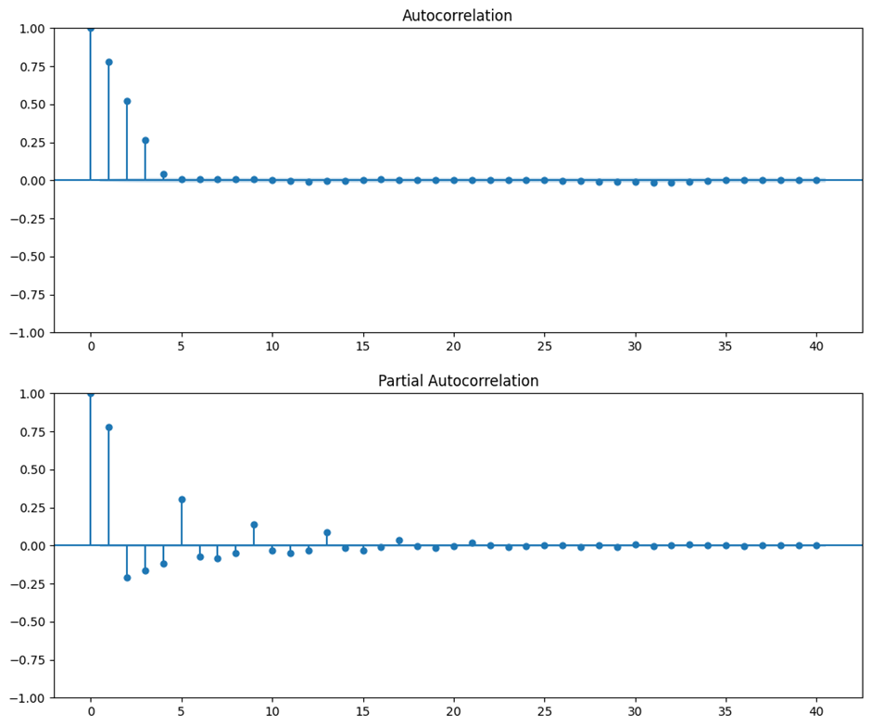
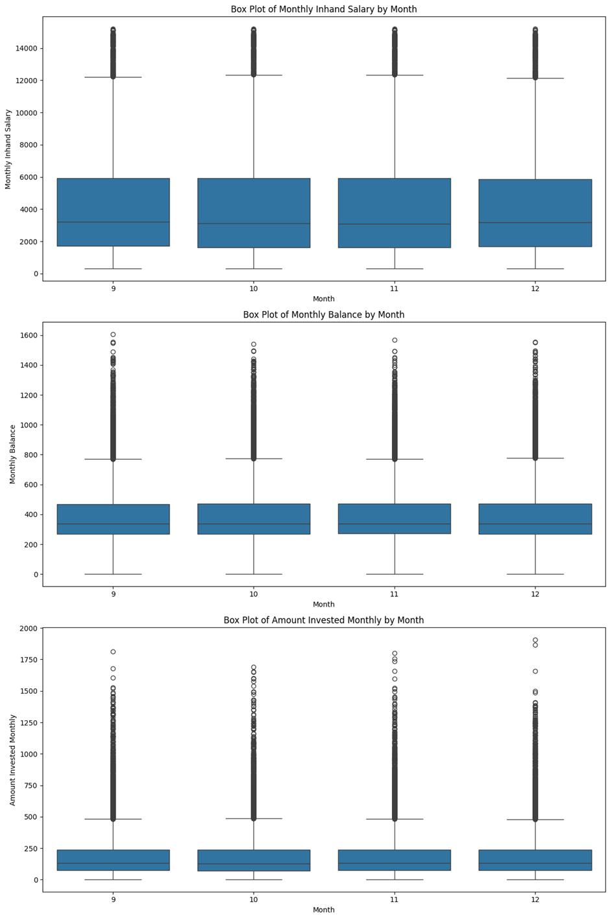
visualization

Slide 24
Visualization highlights
Monthly Inhand Salary: Consistent values observed, indicating potential uniformity or data scaling issues.
Monthly Balance: Displays variability with numerous outliers, suggesting diverse financial behaviors among customers.
Amount Invested Monthly: Exhibits fluctuations and extreme variations, highlighting significant changes in investment behaviors over time.
ADF test results:
1. ADF Statistic: -43.735448, which is significantly below the 1% critical value of -3.430.
2. p-value: 0.000000, indicating strong evidence against the null hypothesis of a unit root (non-stationarity).
KPSS Test Results:
1. KPSS Statistic: 0.168133, which is below the critical values at all significance levels.
2. p-value: 0.100000, suggesting that the null hypothesis of stationarity cannot be rejected at the 10% level.
3. These test results suggest that your series is stationary, which is a necessary condition for using ARIMA models.

Slide 25
Time series analysis
ACF and PACF Plots:
ACF exhibits significant lag at 1, suggesting an AR(1) process.
PACF confirms AR(1) suggestion with a significant spike at lag 1.
Stationarity Checks:
Both ADF and KPSS tests confirm series stationarity, crucial for ARIMA modeling.
ACF and PACF Insights:
Significant correlation at the first lag implies potential ARIMA(1,0,0) model suitability.
ACF tailing off and sharp cut-off in PACF after first lag support AR model usage.
Model Simplicity:
ARIMA(1,0,0) recommended for time series forecasting due to simplicity and robustness.

Slide 26
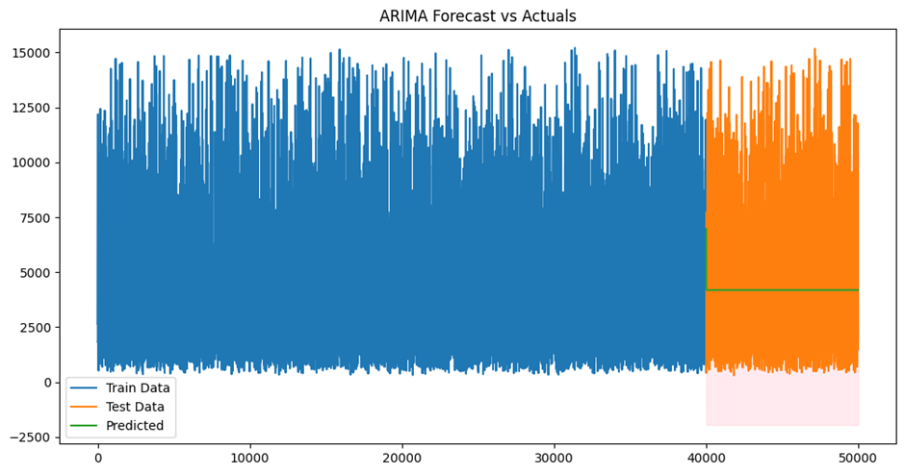
Arima model evaluation
Visual Analysis:
ARIMA forecast resembles a flat line, indicating a constant prediction.
Implications:
Model may not capture fluctuations or trends present in actual data.
Simple ARIMA model might not adequately address underlying patterns like trends or seasonal effects.

Slide 27
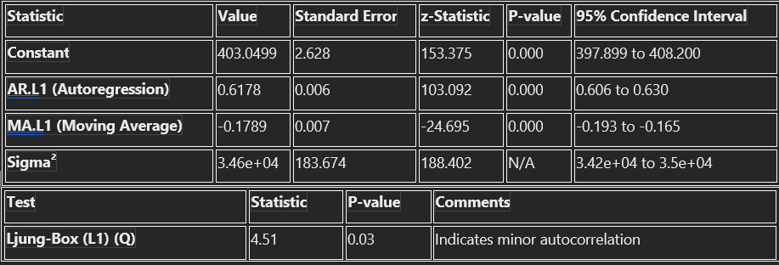
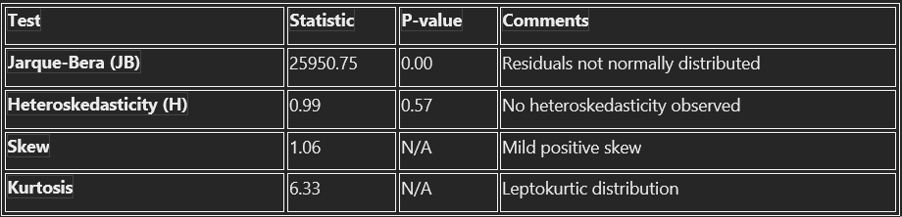
Sarimax results:
The SARIMAX (Seasonal AutoRegressive Integrated Moving Average with eXogenous factors) results typically include statistical tests and diagnostic information related to the model's fit. These may encompass tests for residual autocorrelation, normality of residuals, heteroskedasticity, skewness, and kurtosis, among others.

Slide 28
Model parameters
Constant (4183.3766): Represents the average monthly in-hand salary, suggesting the series centers around this mean.
AR.L1 (0.6984): Significant autoregressive coefficient close to 1 indicates strong persistence, with past values influencing current ones considerably.
MA.L1 (0.2078): Positive moving average coefficient implies previous prediction errors are integrated into current forecasts.
Statistical Tests:
Sigma² (3.758e+06): High variance of residuals suggests significant deviations from model predictions.
Ljung-Box Test: Low p-value indicates residual autocorrelations at lag 1, suggesting potential model shortcomings.
Jarque-Bera Test: Reveals non-normal distribution of residuals, common in financial time series data, suggesting skewness or kurtosis issues.
Model Fit:
Log Likelihood, AIC, and BIC: Indicators of model fit, providing insight into the quality of predictions.

